Slide 1
Introduction to Machine Learning
Chris Paradis

Slide 2
About Me
MS Information Technology and Web Science – Data Science and Analytics
Data Science Intern – Apple Inc.
Machine Learning
Intelligent prediction system for business
Data Science Intern – Symantec
Virus Network Prediction

Slide 3
What is Machine Learning
“Machine learning is a method of data analysis that automates analytical model building. Using algorithms that iteratively learn from data, machine learning allows computers to find hidden insights without being explicitly programmed where to look.”

Slide 4
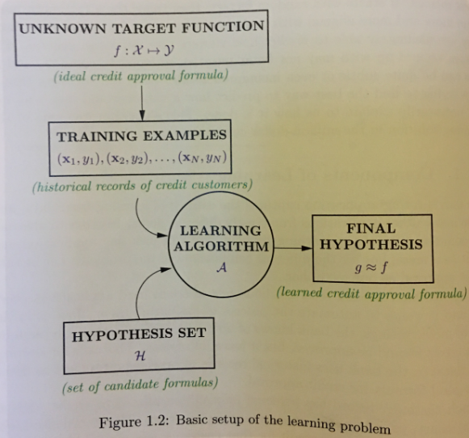
Source: Learning From Data, pg. 4

Slide 5
Vs Statistics
Statistical models have a theory behind the model that is mathematically proven
This requires that data meets certain strong assumptions too
Machine learning uses computers to probe the data for structure
Do not have a theory of what that structure looks like
The test for a machine learning model is a validation error on new data, not a theoretical test that proves a null hypothesis.

Slide 6
VS AI
Depends on who you ask
Computers and systems that are capable of coming up with solutions to problems on their own
Fed information needed to get the solution and use it to come up with a solution on its own without explicit training
Notes:
The solutions aren’t hardcoded into the program; instead, the information needed to get to the solution is coded and AI (used often in medical diagnostics)

Slide 7
What can you do with it?
Three Types of Problems
Supervised
Unsupervised
Reinforcement
Notes:
Coin: that’s a quarter, that’s a dime
Unsupervised: That’s a cluster, that’s another cluster
Renforcement:

Slide 8
Supervised
Trained using labeled examples
Desired output is known
Methods include classification, regression, etc.
Uses patterns to predict the values of the label on additional unlabeled data

Slide 9
Unsupervised
Used against data that has no historical labels
The system is not told the "right answer"
Goal is to explore the data and find some structure within the data
Clustering
Notes:
Unsupervised learning works well on transactional data. For example, it can identify segments of customers with similar attributes who can then be treated similarly in marketing campaigns. Or it can find the main attributes that separate customer segments from each other. Popular techniques include self-organizing maps, nearest-neighbor mapping, k-means clustering and singular value decomposition. These algorithms are also used to segment text topics, recommend items and identify data outliers.

Slide 10
Reinforcement
Algorithm discovers through trial and error which actions yield the greatest rewards.
Three primary components:
the agent (the learner or decision maker),
the environment (everything the agent interacts with)
actions (what the agent can do).
Objective: the agent chooses actions that maximize the expected reward over a given amount of time.
Notes:
The agent will reach the goal much faster by following a good policy. So the goal in reinforcement learning is to learn the best policy.

Slide 11
Why use it?
Machine learning based models can extract patterns from massive amounts of data which humans cannot do because
We cannot retain everything in memory or we cannot perform obvious/redundant computations for hours and days to come up with interesting patterns.
“Humans can typically create one or two good models in a week; machine learning can create thousands of models in a week” (Thomas H. Davenport)
Solve problems we simply could not before

Slide 12
Use Cases
Email spam filter
Recommendation systems
Self driving car
Finance
Image Recognition
Competitive machines

Slide 13
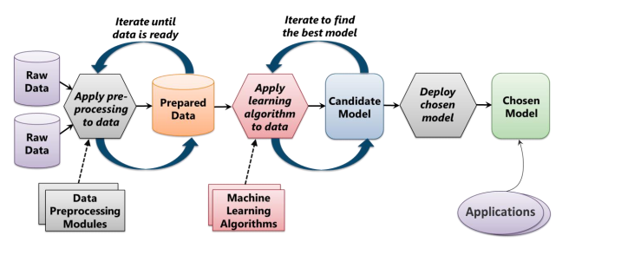
Typical Machine Learning Process
Source: INTRODUCING AZURE MACHINE LEARNING, pg. 5

Slide 14
To give Credit, or not to give credit
You are asked by your boss while working at Big Bank Inc. to develop an automated decision maker on whether to give a potential client credit or not.

Slide 15
What is the question?
What question are we trying to answer here? What problem are we looking to solve?
Notes:
In WWII, Allied bombers were key to strategic attacks, yet these lumbering giants were constantly shot down over enemy territory. The planes needed more armor, but armor is heavy. So extra plating could only go where the planes were being shot the most.
A man named Abraham Wald, a Jewish mathematician who’d been locked out of university positions and ultimately fled the persecution in his own home country of Hungary, was brought in to oversee the operation. He started with a simple diagram—the outline of a plane—and he marked bullet holes corresponding to where each returning bomber had been shot. The result was the anatomy of common plane damage. The wings, nose, and tail were blackened with bullet holes, so these were the spots that needed more armor.

Slide 16
Selecting Data
Feature
An individual measurable property of a phenomenon being observed
Best found through industry experts

Slide 17
Selecting Data
Feature Extraction
Feature extraction is a general term for methods of constructing combinations of the variables to get around certain problems while still describing the data with sufficient accuracy.
Analysis with a large number of variables generally requires a large amount of memory and computation.
Reducing the amount of resources required to describe a large set of data

Slide 18
Selecting Data
PCA (Principal Competent Analysis)
We have a huge list of different features
Many of them will measure related properties and so will be redundant
Summarize with less features

Slide 19
Who Cares

Slide 20
Preparing Data
Cleaning
Units
Missing Values
Metadata

Slide 21
Developing Model
What is the problem being solved?
What is the goal of the model?
Minimize least squared error on the “training” data
Training data is the data used to train the model (all of it but the part we removed)
Notes:
Draw on board

Slide 22
Developing Model
Linear Model
Relationships are modeled using linear predictor functions whose unknown model parameters are estimated from the data
Complex way of saying the model draws a line between two categories (classification) or to estimate a value (regression)
Linear regression the most common form of linear model

Slide 23
Developing Model
Non-linear Model
A nonlinear model describes nonlinear relationships in experimental data
The parameters can take the form of an exponential, trigonometric, power, or any other nonlinear function
Notes:
Draw example on board, why ever use linear then?

Slide 24
Developing Model
Overfitting
Fitting the data more than is warranted
Leads to a smaller error in our data set (Ein) but a larger one on data outside of our training data (Eout)
Notes:
Draw example on board

Slide 25
Developing Model
Rule Addition
Minimize least squared error on the “training” data (Ein)
AND make sure that Eout is close to Ein
Notes:
Draw example on board

Slide 26
Developing a model
Keep it Simple
Go for simpler models over more complicated models
Generally, the fewer parameters that you have to tune the better
Cross-Validation
K-fold cross validation is a great way to estimate Eout
Regularization
Can sometimes help penalize certain sources of overfitting.
LASSO
Forces the sum of the absolute value of coefficients to be less than a fixed value
Effectively choosing a simpler model
Notes:
More data

Slide 27
Developing a model
Data Snooping
“If a data set has affected any step in the learning process, its ability to access the outcome has been compromised”
Experimenting
Reuse of the same data set to determine quality of model
Once a data set has been used to test the performance of a data set, it should be considered contaminated
Source: Learning From Data, pg. 173

Slide 28
Developing a model
Random Forest
SVM
Linear Regression
Kmeans clustering
K nearest neighbor
Naïve bayes
Neural Networks

Slide 29
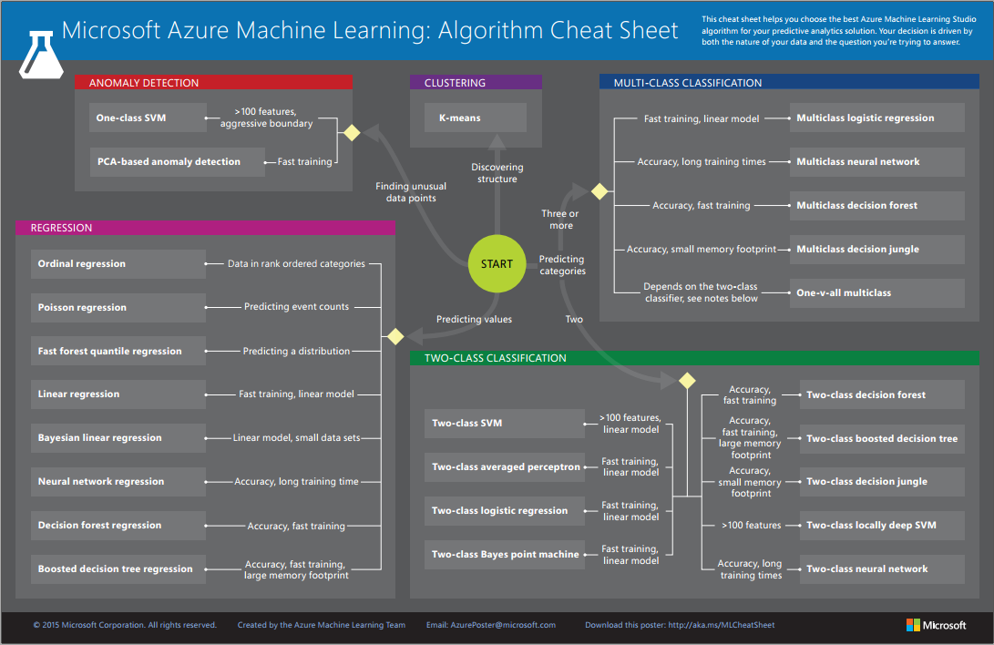
Notes:
https://azure.microsoft.com/en-us/documentation/articles/machine-learning-algorithm-cheat-sheet/

Slide 30
Interpreting Results
Validation
Cross validation
Test set
Once the test set has been used, you must find new data!

Slide 31
Deep Learning
Deep learning is usually a rebranding of neural networks
Some popular use cases:
Colorization of Black and White Images
Adding Sounds To Silent Movies
Automatic Machine Translation
Object Classification in Photographs
Automatic Handwriting Generation
Character Text Generation
Image Caption Generation
Automatic Game Playing

Slide 32
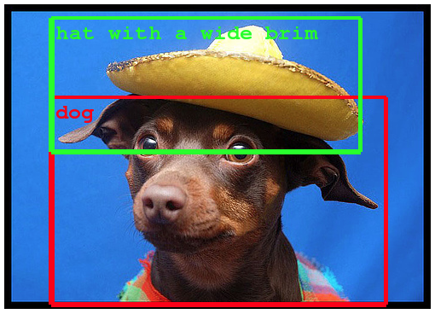
Notes:
Object Classification and Detection in Photographs

Slide 33
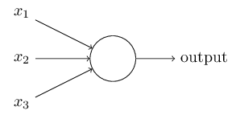
History of Neural Networks
Perceptrons
Developed in the 1950s and 1960s by Frank Rosenblatt
Classification based upon threshold
Notes:
X_1 = 1 if the weather is good
X_2 = 1 if the professor is good
X_3 = 1 if you got enough sleep last night
You refuse to walk in the rain, and the other 2 aren’t that important.
You can use perceptrons to model this kind of decision-making. One way to do this is to choose a weight
w_1=6 for the weather
w2=2 and w3=2 for the other conditions. Threshold of 5 for the perceptron.
Could have easily chosen 3, so if the professor was good and got enough sleep you would go.

Slide 34
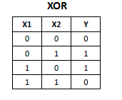
History of Neural Networks
Marvin Minsky and Seymour Papert
Proved that perceptron could not be trained to recognize several types of patterns
XOR problem

Slide 35
History of Neural Networks
Yann Lecun
Director of Facebook AI Research
Largely credited with invention of effective implementation of “hidden layers”

Slide 36
Train our own Artificial Neural Network
Predicting success of Machine Learning Talk

Slide 37
Conclusion
ML can solve numerous problems
Deep learning can solve even cooler problems
Take Malik’s course if you are interested!

